Slide 1
Team 3 Better Software
Gary Johns
Dan Lain
Jose Flores

Slide 2
Vision
Create a project management software tool to allow small to medium sized companies to keep track of ongoing projects, employees, and costs. This tool shall allow the company to perform resource tracking, produce cost reports, and velocity tracking. This system will be developed by a small agile team consisting of three hard working developers.

Slide 3
Project Plan

Slide 4
Increment 1 Deliverables
Database Design
User Creation
User Management
Login
Role Creation
Role Management
Company Properties
Rough Interface

Slide 5
Database Design

Slide 6
Employee Setup and Maintainence

Slide 7
Login

Slide 8
Role Management

Slide 9
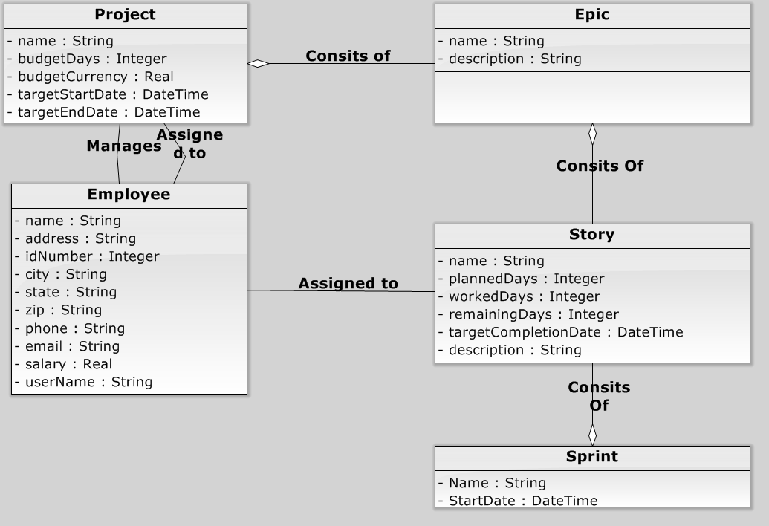
Domain Diagram

Slide 10
Rough Interface - Demo

Slide 11
Increment 2 Deliverables
Project Creation
Project Management
Epic Creation
Epic Management
Story Creation
Story Management
Work Recording
Work Management

